Slide 1
Unveiling Insights
Exploring the General Social Survey Data through Visualization
IS 578 Introduction to Digital Humanities 2023 Fall
Sanchita S. Kamath ssk11@illinois.edu
Inyoung Jang inyoung2@illinois.edu

Slide 2
Introduction to the Workshop - The Scope
Demonstrating the usage of several tools mentioned - or the lack thereof
Familiarising one-self with the data analytics process through hands-on experience
Understanding the visualization generated
Acknowledging the importance of the dataset
Comparing the strengths and limitations of the tools used

Slide 3




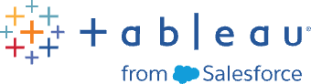


Goals of the Workshop
How to handle a huge dataset?
How can I explore the data?
What kind of visualization is possible?
For beginners who find it is hard to manage a huge dataset with no experience of visualization.
Using following DH tools to clean, explore, visualize, and understand the social survey data from 1972~2015.
Requirements: Internet access, Google Drive account, email address, OpenRefine, Tableau

Slide 4
Introduction to the Dataset
2.07 GB Dataset
Attribute Sheet
Conducted Attribute Extraction to match the scope of the workshop
Include Attributes focused on the lifestyle and behaviour of individuals
Looking at stemmed choices and thoughts instead of understanding what led to those thoughts being generated
Paving the way to connect several lifestyle choices and underlying reasoning.
Two Manually cleaned Datasets - Living Conditions and Opinions

Slide 5
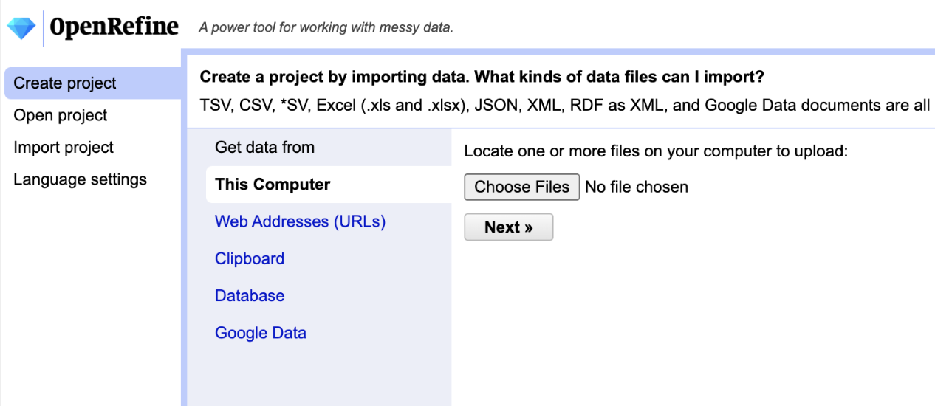
Free and open source
A powerful DH tool for data cleaning
Download is required

Slide 6
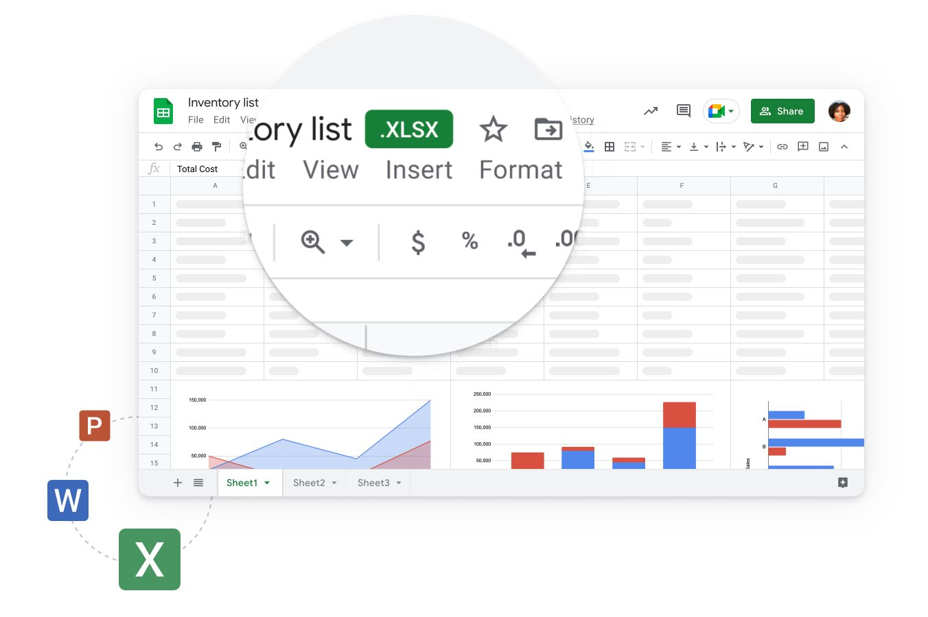
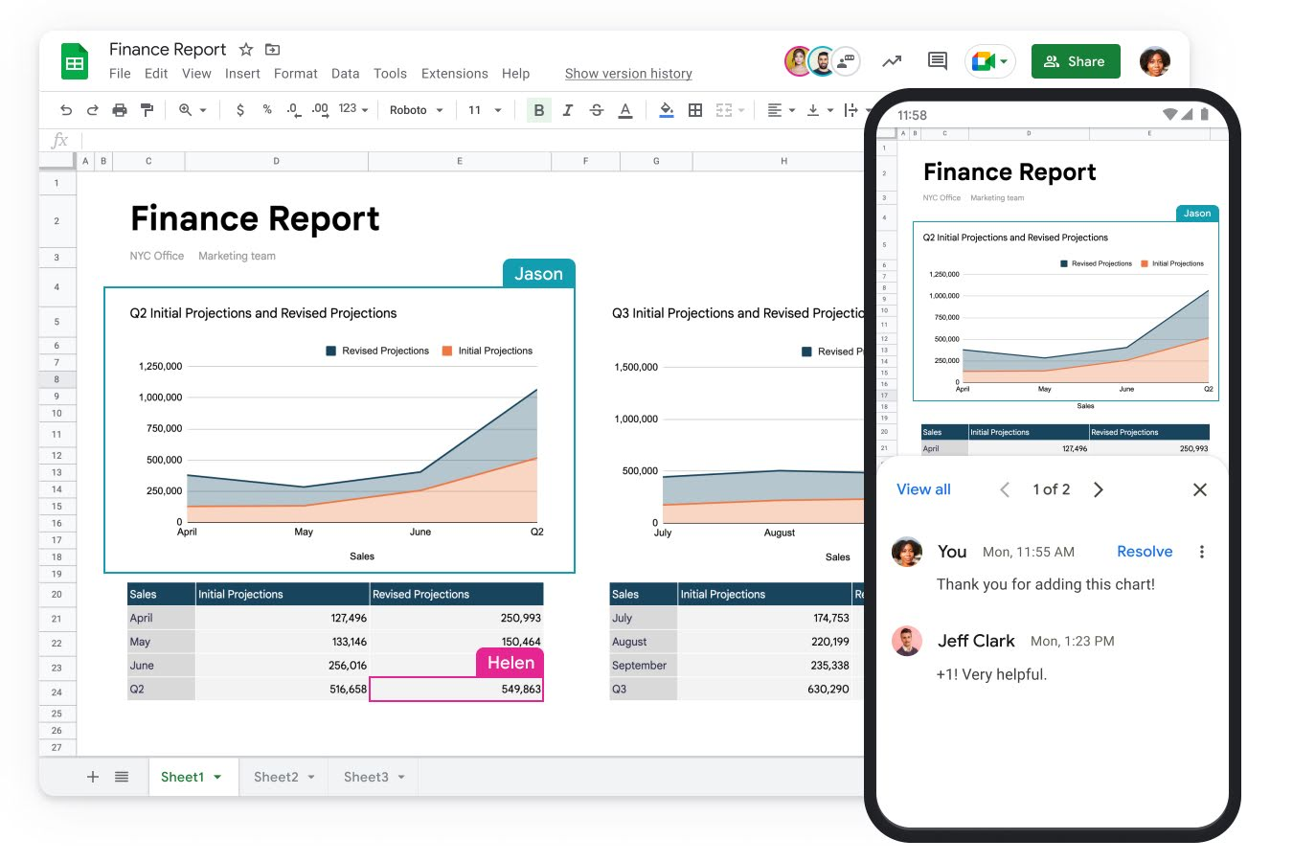
Free online real-time collaboration
Connectivity with other Google apps and various formats
Sign-up is required

Slide 7
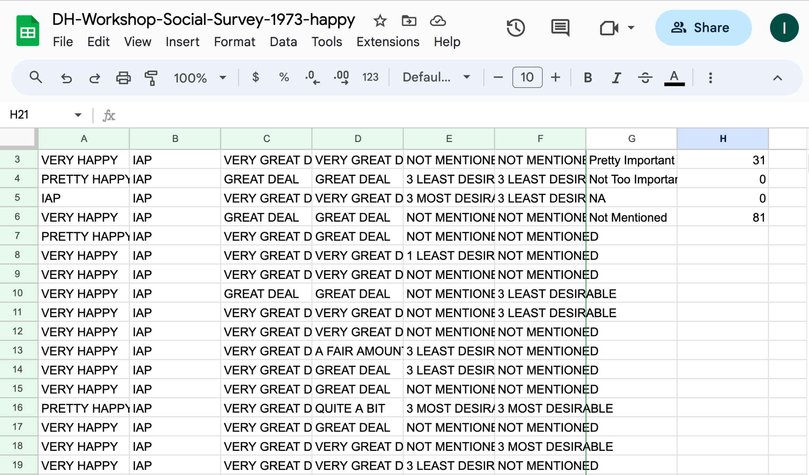
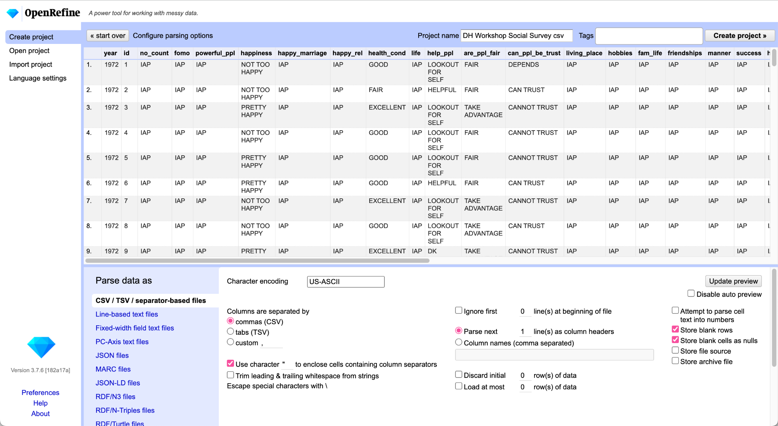
Data Cleaning & Manipulation
Counting, transposing, and calculation

Slide 8
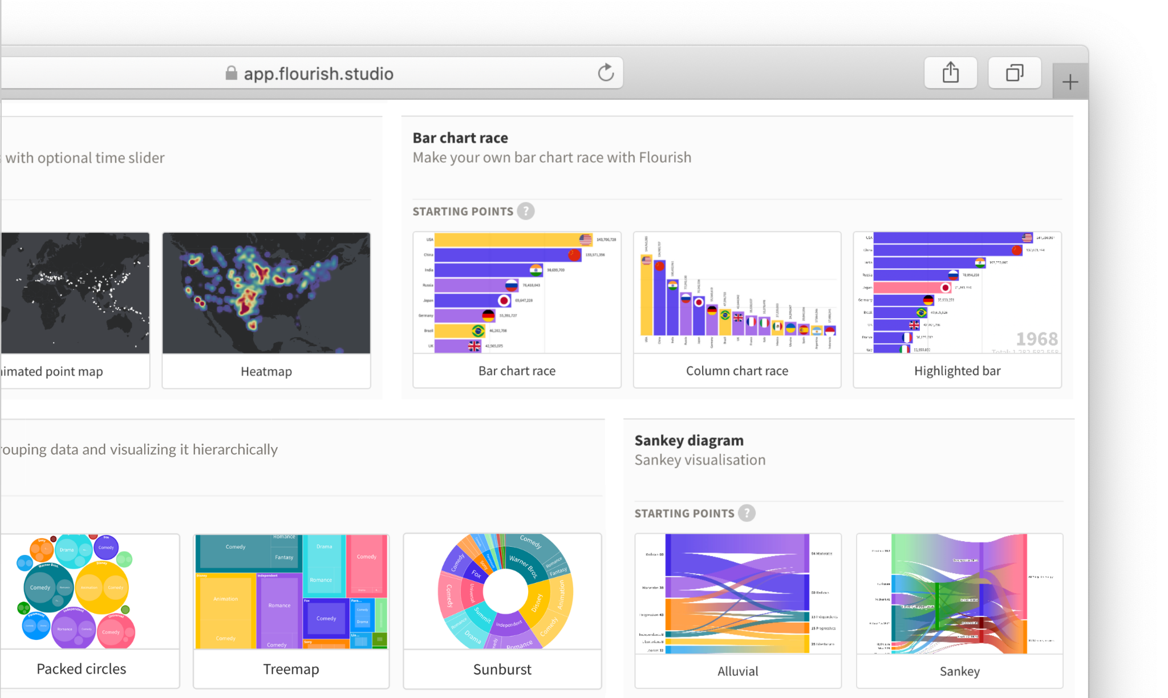
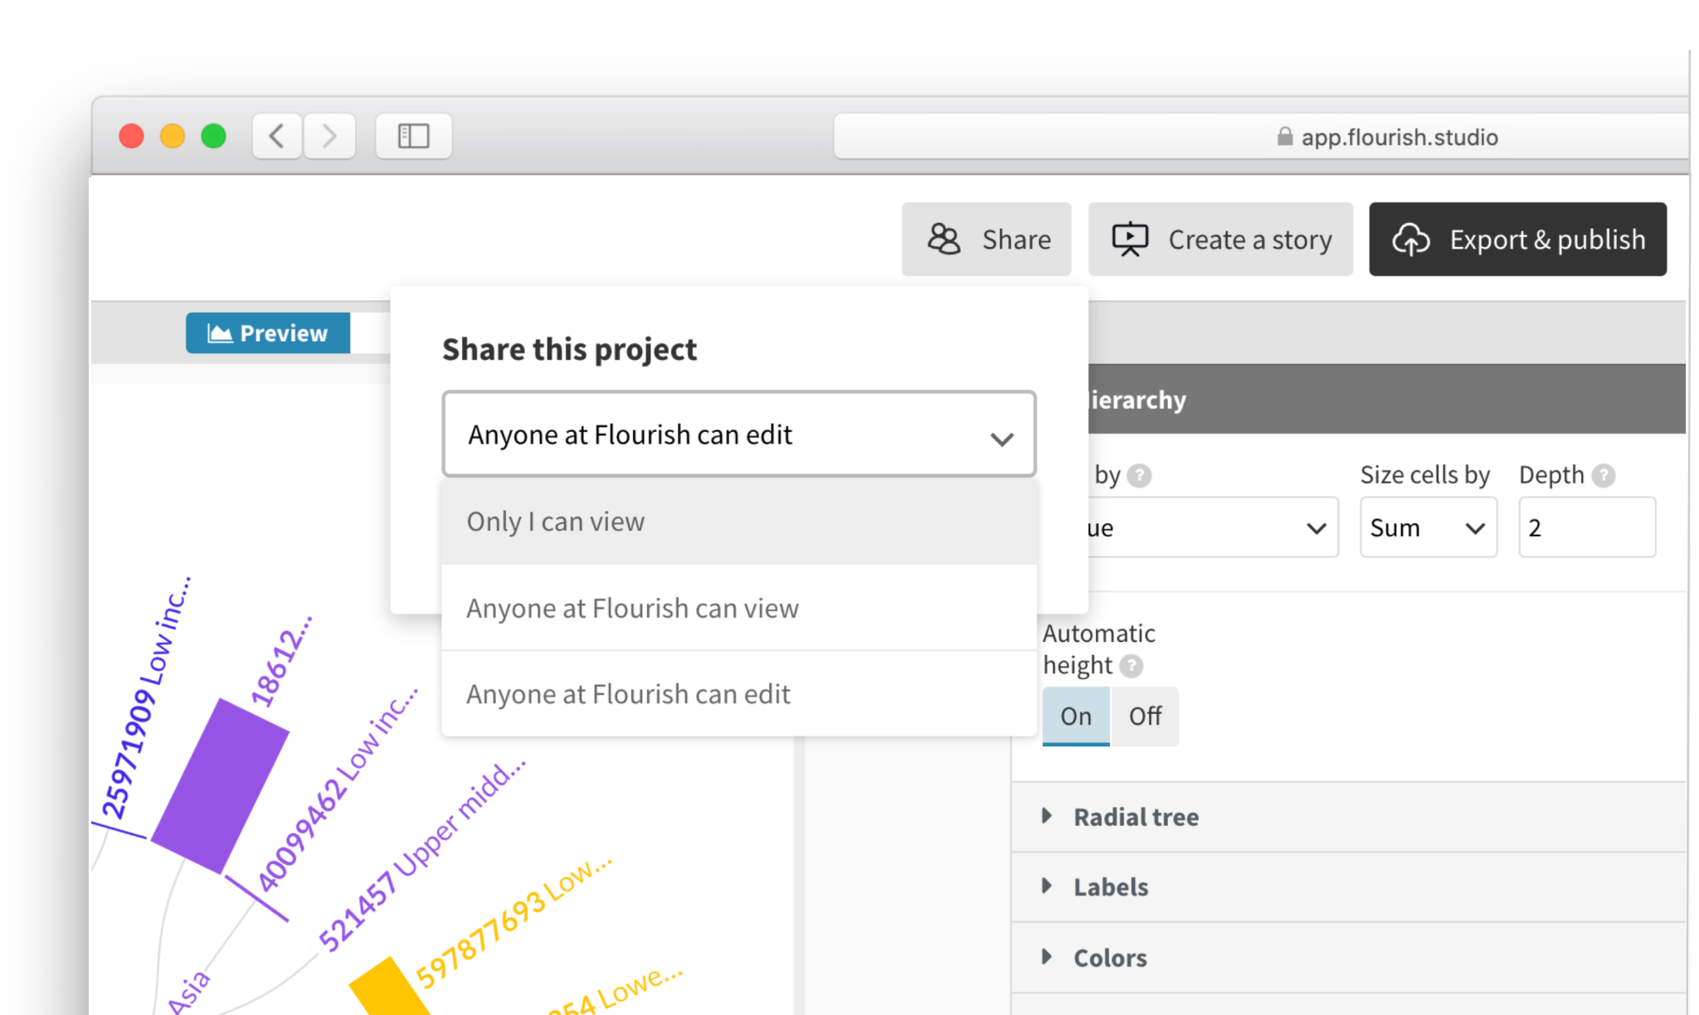
Web-based tool for Data chart visualization and map storytelling
Interactive templates and tutorials with unlimited free public views
Easy collaboration and co-editing
No download but sign-up with email

Slide 9
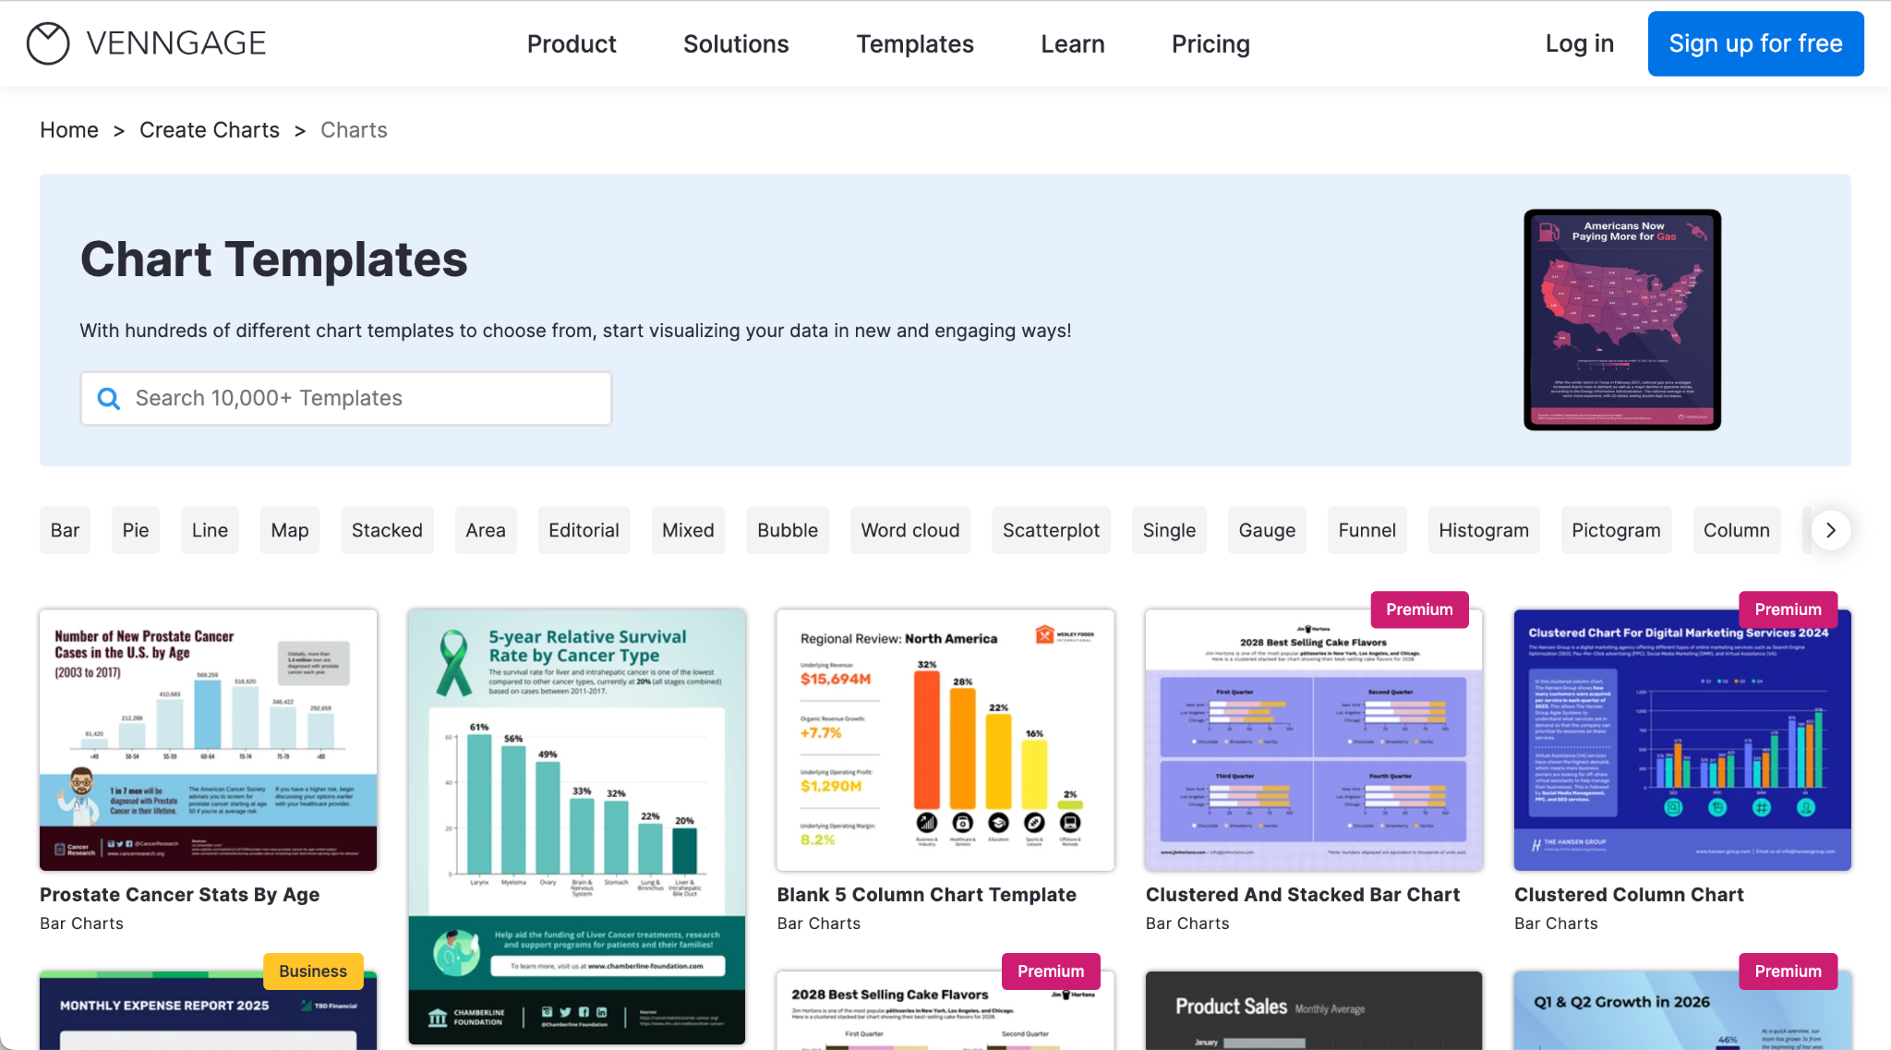
Web-based visualization tool ideal for beginners
A simple interface with various chart templates for interactive visualization
Specialized on survey data visualization
High customizability
Requires sign-up with email address

Slide 10
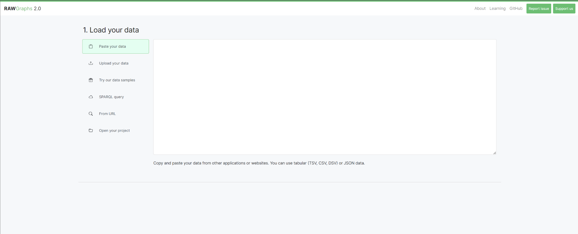
Flexibility and Creativity
Diverse Chart Types
Customization Options
Open Source and Free

Slide 11
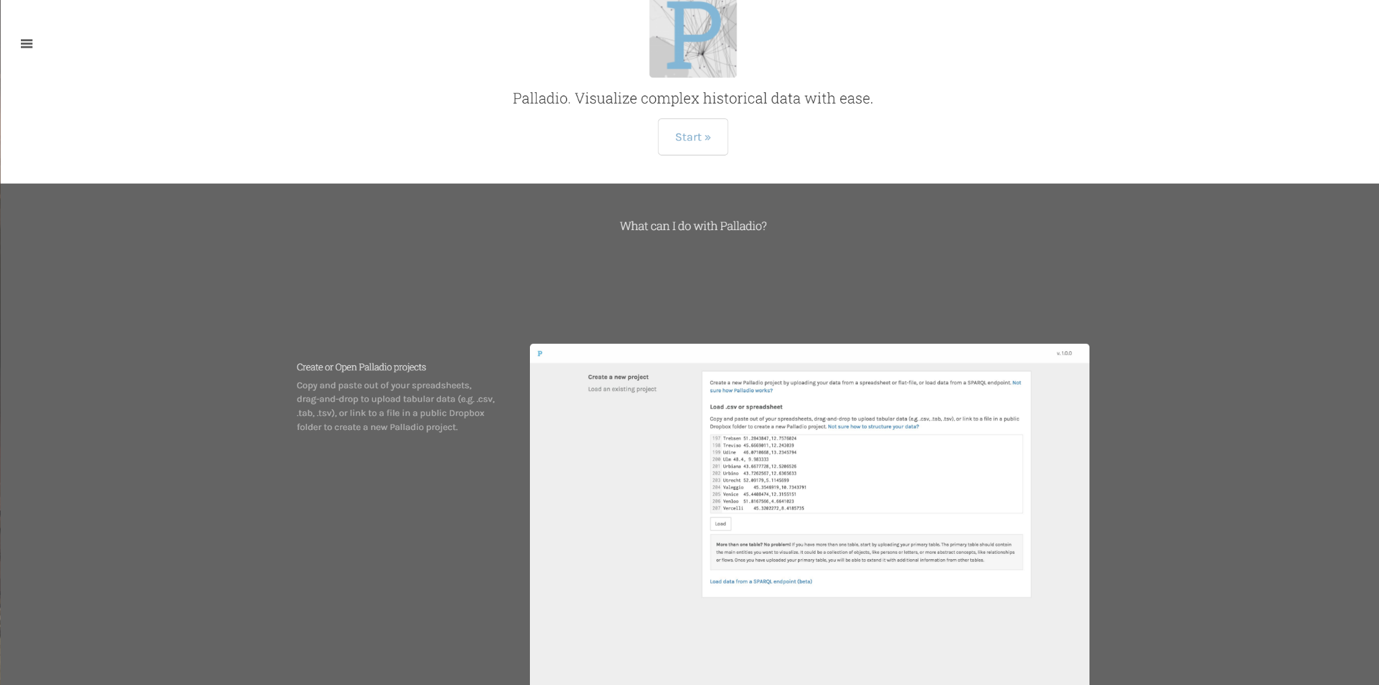
Palladio
Interactive Exploration
Temporal Analysis
Export and Shareability
Open Source and Free

Slide 12
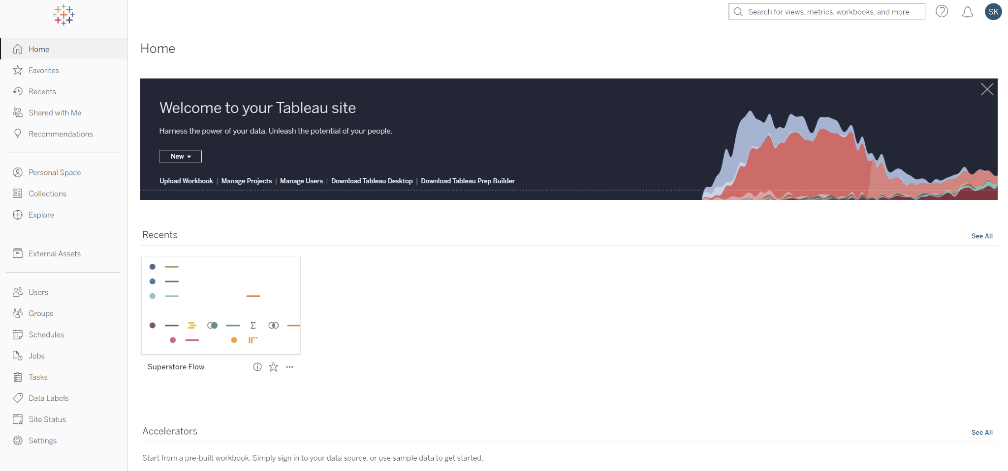
Comprehensive visualization construction
Advanced analytics and calculations
Real-time data update - SQL connects
Scalability

Slide 13
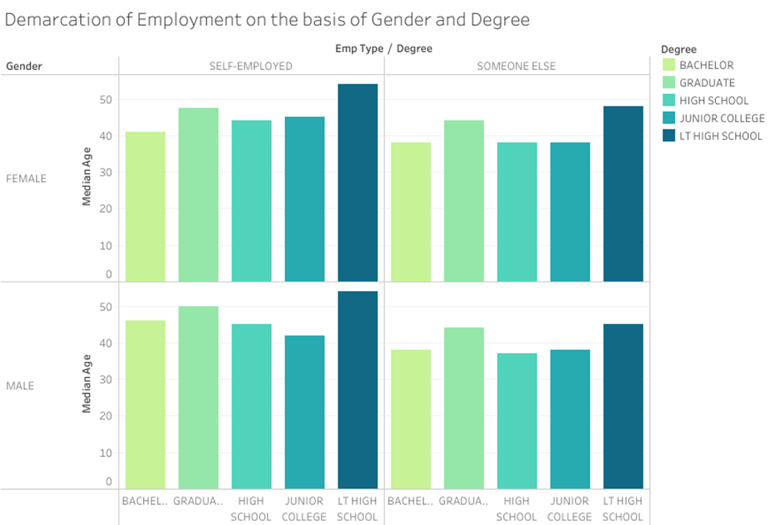

Slide 14
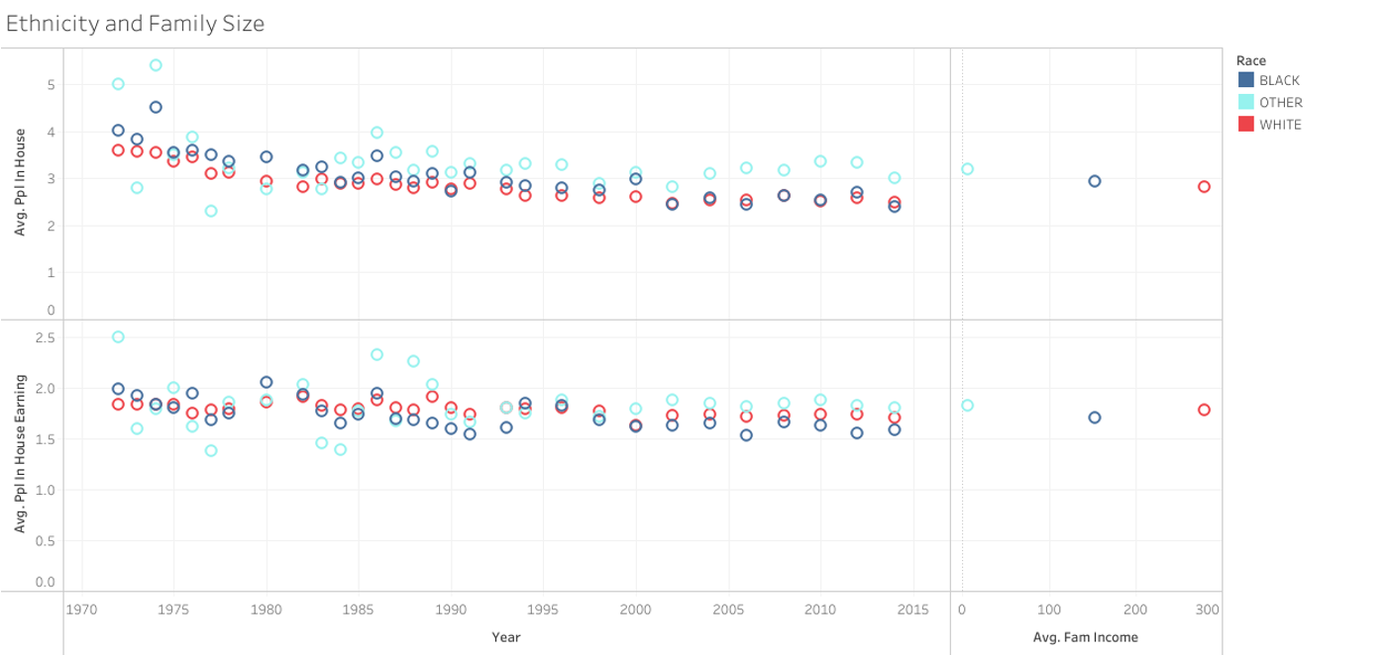

Slide 15
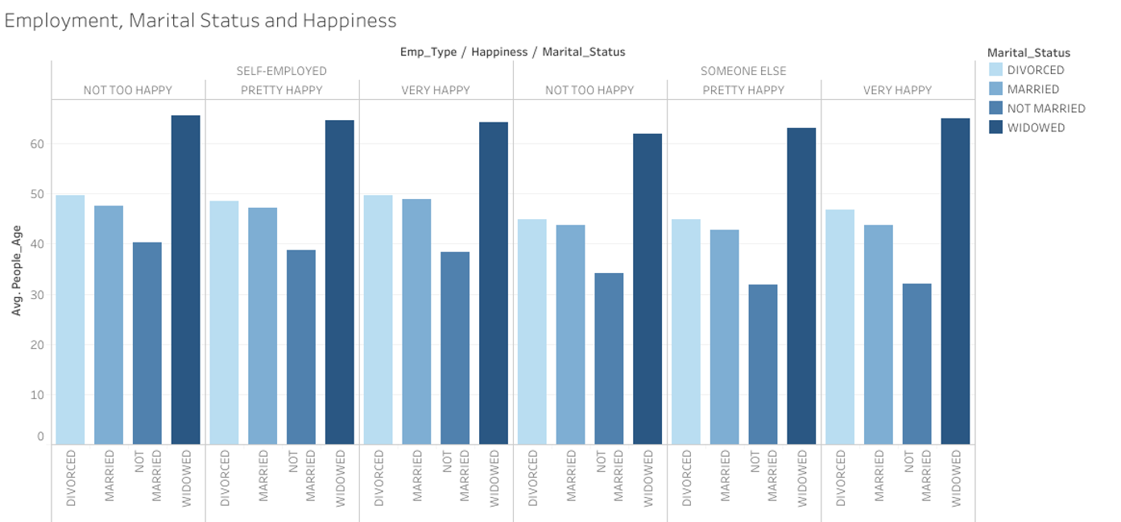

Slide 16
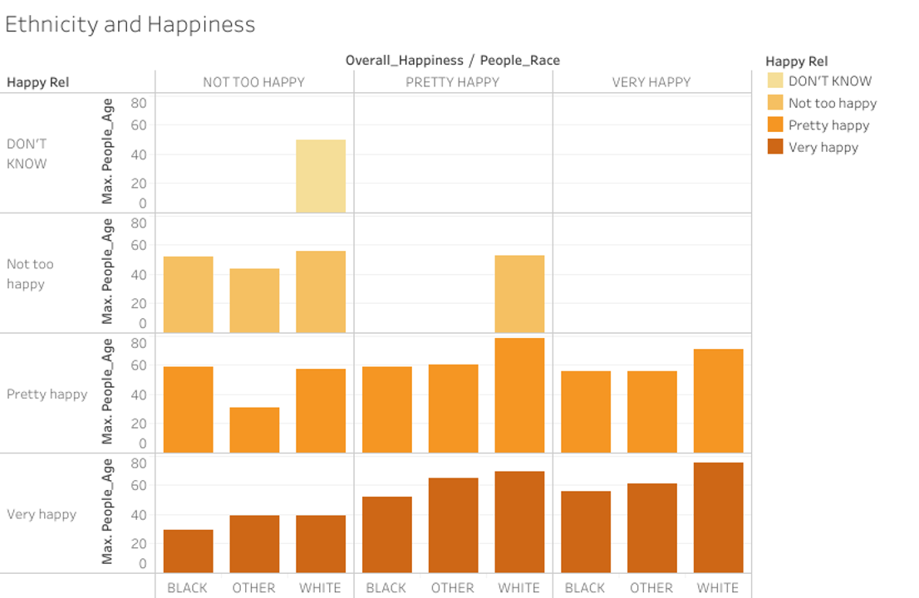

Slide 17
Comparing Our Tools

Slide 18
Thank You
For joining the DH journey with us
IS 578 Introduction to Digital Humanities 2023 Fall
Questions, Comments, Suggestions:
ssk11@illinois.edu inyoung2@illinois.edu

